Slide 1
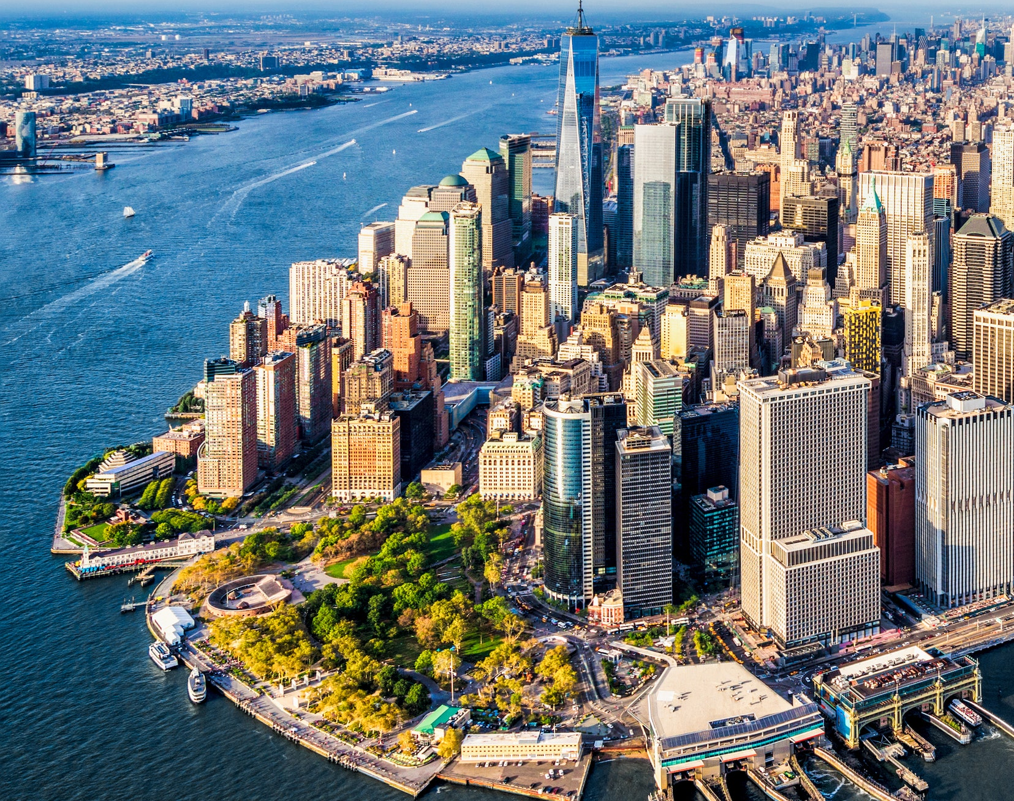
Best location for access to pizza in NY
Battle of Neighborhoods

Slide 2
Background
As part of the capstone project, we develop a report outlining a business problem that needs to be solved utilizing location data.
This project navigates through a dataset, prepare the data analysis, results, including observations, and conclusion.

Slide 3
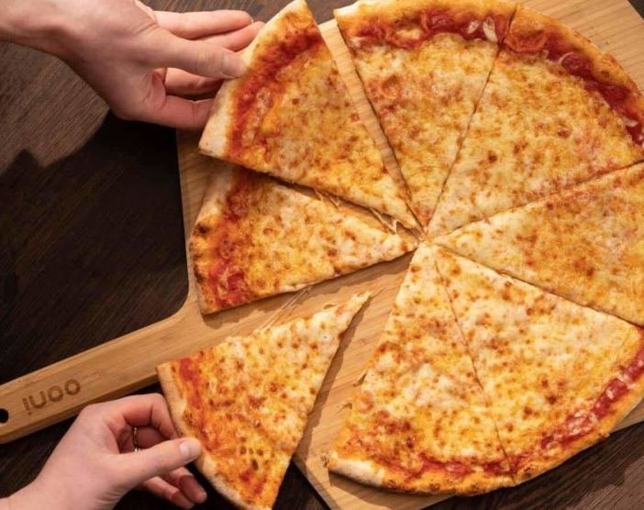
The problem
In this project we look at the most desirable location to access pizza in New York City efficiently.
Specifically the problem we aim to solve is which location should we stay to have greatest range of pizza venues in New York City

Slide 4
Data and Method
We have used FourSquare API to gather data about pizza venues in New York City.
To determine this we are determining pizza venue density in New York City. FourSquare near query has been used to get the venues in the city.
A centre coordinate has been calculated on the pizza venues to get the longitude and latitude values. Then the mean was calculated of the Euclidean distance from each pizza venue to the mean coordinates.

Slide 5
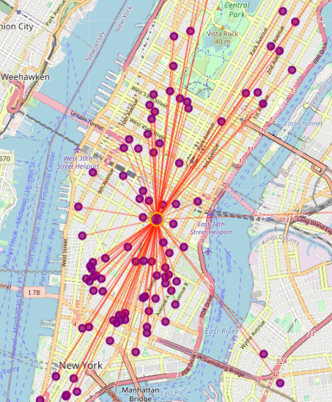
Conclusion
After considering the result it appears the neighbourhood around Madison Square Park is the best location for access to pizza venues.

